Slide 1
AEM 2210
Financial Accounting
Chapter 01: Financial Statements and Business Decisions
Professor Sinclair
Spring 2018

Slide 2
Chapter 01 Learning Objectives
Recognize the information conveyed in each of the four basic financial statements and the way that this information is used by different decision makers (investors, creditors, analysts, and managers)
Identify the role of Generally Accepted Accounting Principles (GAAP) in determining financial statement content and how companies ensure the accuracy of their financial statements

Slide 3
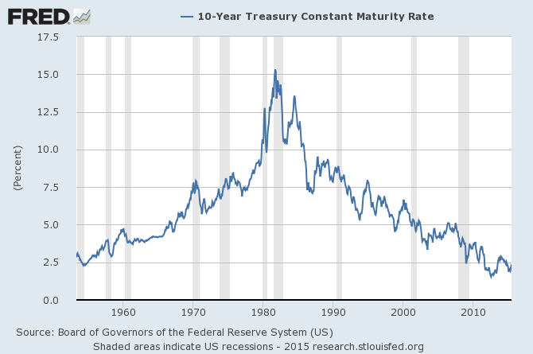
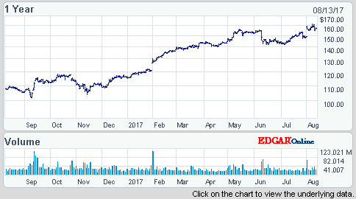
Understanding the Business
Businesses are started by owners, or stockholders, of a company.
Creditors:
Banks and other lenders become creditors who help finance the business. Creditors make money on loans by charging interest.
Stockholders:
Additional individuals may became part owners or stockholders. They hope to receive a portion of what the company earns in the form of cash payments called dividends and to eventually sell their share of the company at a higher price than they paid.
The willingness of creditors to lend and of additional stockholders to invest depends on the expected future performance of the company. Both groups often judge future performance based on information in the company’s financial statements.

Slide 4
The Accounting System
The accounting system collects and processes financial information about an organization and reports that information to decision makers. The accounting system provides financial accounting reports, which include periodic financial statements and related disclosures, to external decision makers.
These decision makers include investors, creditors, suppliers, customers, union representatives, and all other interested parties. The accounting system also provides managerial accounting reports, including detailed plans and continuous performance reports.
These reports are used by internal decision makers throughout the organization to make decisions about pricing, production, quality, performance evaluation, and numerous other day-to-day activities.

Slide 5
Financial Statements

Slide 6
Four Basic Financial Statements
Companies usually publish four (4) basic financial statements, as follows:
Balance Sheet
reports the amount of assets, liabilities, and stockholders’ equity of an accounting entity at a point in time
Income Statement
reports the revenues less the expenses of the accounting period
Statement of Stockholders’ Equity
reports the changes in each of the company’s stockholders’ equity accounts, including the change in the retained earnings balance caused by net income and dividends during the reporting period
Statement of Cash Flows
reports inflows and outflows of cash during the accounting period in the categories of operating, investing, and financing
Notes are an integral part of these financial statements

Slide 7
Four Basic Financial Statements
For all financial statement items, an item should only be recognized in the financial statements if it is probable that any future economic benefit associated with the item will flow to or from the entity and if the item has a cost or value that can be measured with reliability.

Slide 8
Balance Sheet¹
Assets | Liabilities
 | Equity
Assets = Liabilities + Stockholders’ Equity
¹ The Balance Sheet may also be referred to as the Statement of Financial Position or Statement of Financial Condition

Slide 9
Balance Sheet
The purpose of the balance sheet is to report the financial position (assets, liabilities, and stockholders’ equity) of an entity at a particular point in time.
Assets
Economic resources owned or controlled by the company. All assets are expected to provide future benefits to the company. The exact list of assets depends on the individual company; however, some common assets are: cash, short-term investments, accounts receivable, inventory, supplies, prepaid expenses, long-term investments, equipment, buildings, land, intangibles, etc.
Liabilities
The company’s debts or obligations (claims to a company’s resources) arising from past events, the settlement of which is expected to result in an outflow of economic benefits from the company. Liabilities include sources of financing provided by creditors. Examples include: Accounts payable, accrued expenses, notes payable, taxes payable, long-term debt, unearned revenue, bonds payable, etc.
Stockholders’ equity
Common stock - indicates the amount of financing provided by owners (stockholders) of the business.
Retained Earnings - the amount of earnings that have been reinvested in the business rather than being distributed as dividends to shareholders.

Slide 10
Balance Sheet
Why is the Balance Sheet important?
It is the fundamental report of an entity’s possessions, debt, and capital invested
Investors often use the company’s balance sheet to examine key elements:
Can the firm meet its financial obligations?
How much money has already been invested in the company?
What kind of assets has the company purchased with its financing?

Slide 11
Limitation: Balance Sheet ≠ Value
The balance sheet provides important information about a company’s financial condition
However, balance sheet amounts of equity (assets, net of liabilities) should not be viewed as a measure of either the market or intrinsic value of a company’s equity.
Why?
The balance sheet is a mixed model with respect to measurement (some items at historical cost, some items at current value)
Even current value reflects a value that was current at the end of the reporting period
Future cash flows, which affect value, are driven by items excluded from the balance sheet (e.g., reputation, management skills)

Slide 12

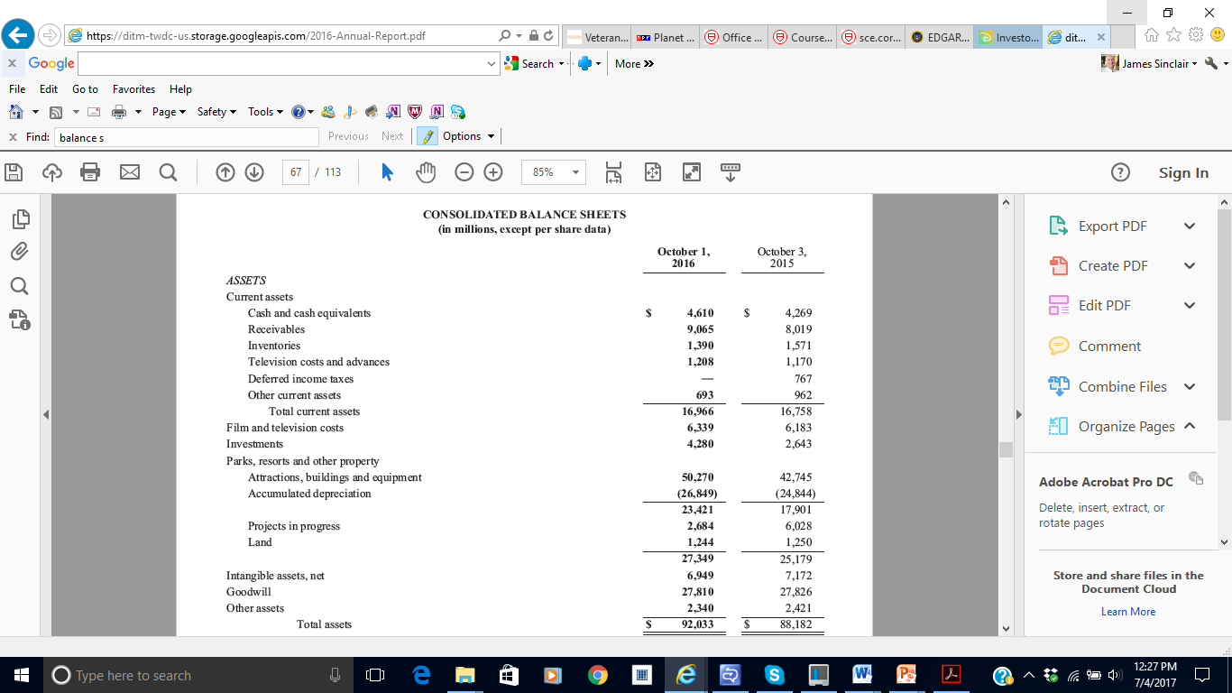
Balance Sheet

Slide 13
Balance Sheet
‘Consolidated’ means all subsidiaries are combined
Point in time for which B/S was created. The B/S is a “snapshot” at any given point in time of the company’s assets, liabilities, and SE
Current Assets: Assets expected to be used or turned into cash within the coming year (or accounting cycle)
Non-Current Assets: Assets expected to be used or turned into cash beyond the coming year (or accounting cycle)

Slide 14
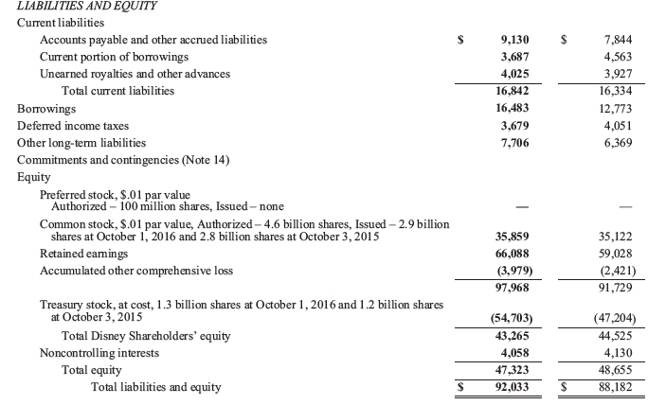
Balance Sheet

Slide 15
Balance Sheet
Current Liabilities: obligations that will be settled by providing cash, goods, or services within the coming year
Non-Current Liabilities: obligations that will be settled by providing cash, goods, or services beyond the coming year
Equity: Contributed capital and retained earnings

Slide 16
Balance Sheet Format
Assets and Liabilities on the Balance sheet are typically ordered according to liquidity*
Companies using U.S. GAAP (i.e., Disney) order items on the balance sheet from most liquid to least liquid.
Although not prescribed, in general, companies using IFRS order balance sheet information from least liquid to most liquid.
* Liquidity
For a company overall, its ability to pay for short-term obligations
For a particular asset or liability, its “nearness to cash”

Slide 17
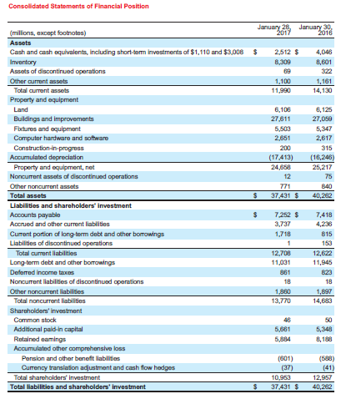

Balance Sheet
Assets
Liabilities and Stockholders’ Equity

Slide 18
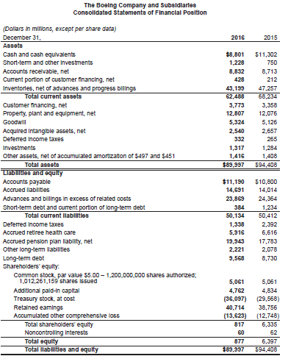

Balance Sheet
Assets
Liabilities and Stockholders’ Equity

Slide 19

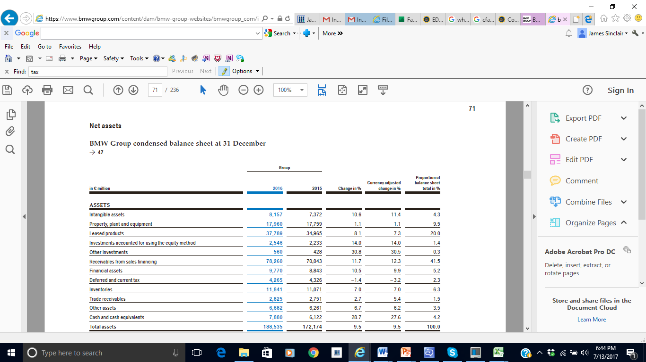
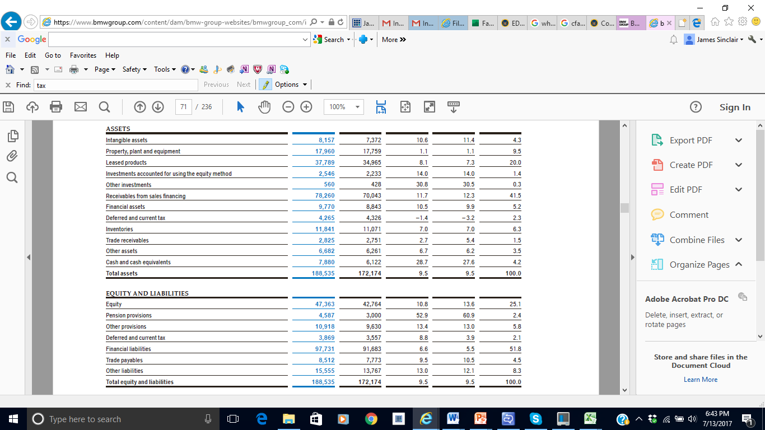
Balance Sheet
Assets
Liabilities and Stockholders’ Equity

Slide 20

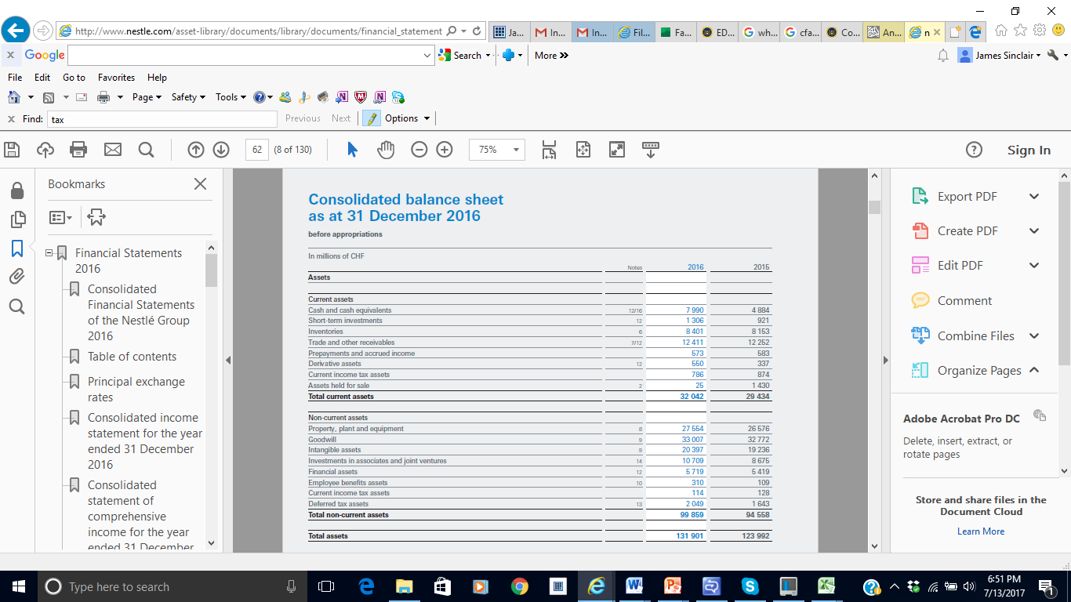
Balance Sheet
Assets

Slide 21
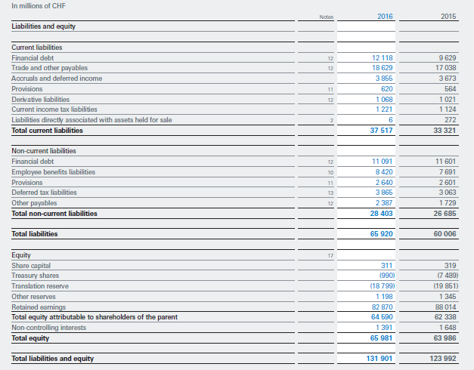
Balance Sheet
Liabilities and Stockholders’ Equity

Slide 22
Income Statement¹
Revenue
Expense
Net Income
¹ The Income Statement may also be referred to as Statement of Earning, Statement of Operations, or Profit and Loss Statement

Slide 23
Income Statement
The income statement reports revenues less expenses during the accounting period. This statement represents the accountant’s primary measure of economic performance during the period.
Revenue
Companies earn revenues from the sale of goods and services to customers. A few examples of revenues include sales revenue, fee revenue, interest revenue, and rent revenue.
Expenses
The dollar amount of resources used to earn revenues during the period. Examples are cost of goods sold, wages expense, rent expense, depreciation expense, insurance expense, maintenance expense, income tax expense, and advertising expense.
When revenues exceed expenses for the period, the company has generated net income. If expenses are greater than revenues in the period, the company has incurred a net loss.
Net Income (loss) = Revenue - Expense

Slide 24

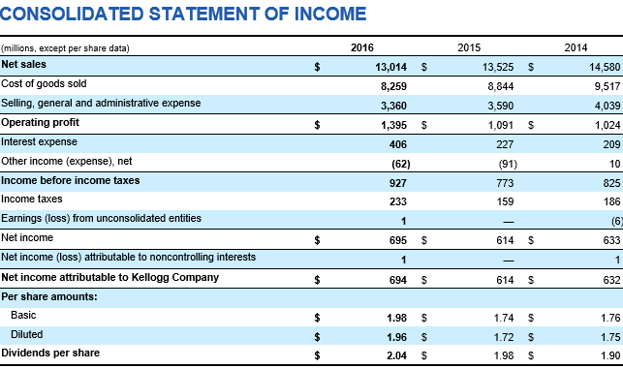
Income Statement

Slide 25
Income Statement Format
Companies may use subtotals to communicate key performance metrics:
Gross profit (margin) (i.e., revenue less cost of sales)
Multistep format: Income statement shows gross profit subtotal
Single-step format: Income statement excludes gross profit subtotal
Operating profit (i.e., revenue less all operating expenses)
Profits before deducting taxes and interest expense and before any other non-operating items
Operating profit and EBIT (earnings before interest and taxes) are not necessarily the same
Expense Grouping

Slide 26

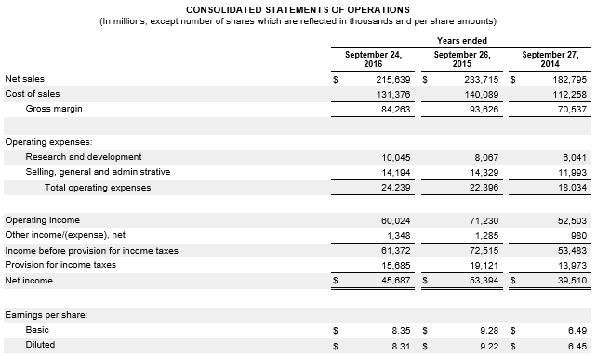
Income Statement

Slide 27
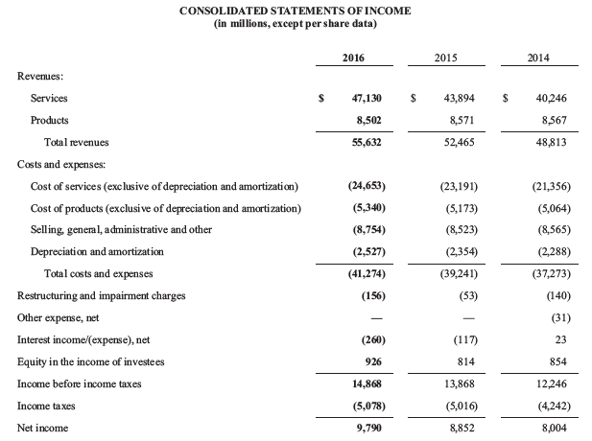
Income Statement

Slide 28
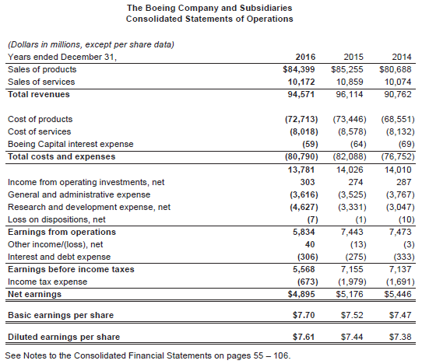
Income Statement

Slide 29
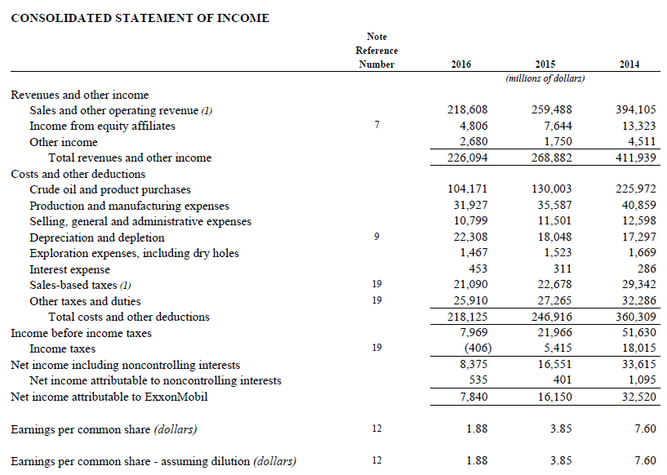

Income Statement

Slide 30

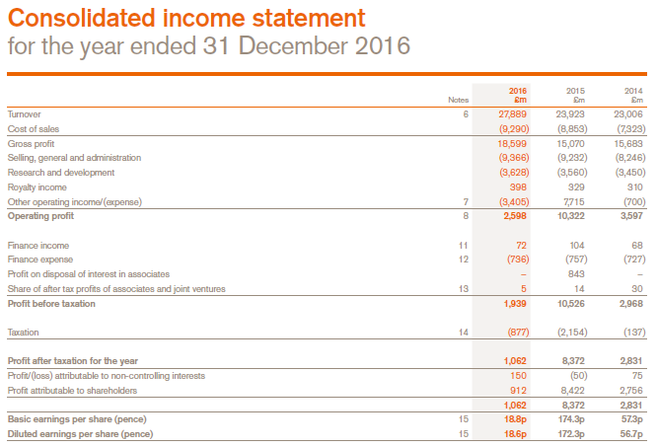
Income Statement

Slide 31
Statement of Stockholders’ Equity
Common Stock and APIC Beg. Bal. + Stock issuances - Stock repurchases End. Bal
Retained Earnings Beg. Bal. + Net Income - Dividends End. Bal

Slide 32
Statement of Stockholders’ Equity
The statement of stockholders’ (shareholders’) equity reports the changes in each of the company’s stockholders’ equity accounts, including the change in the retained earnings balance caused by net income and dividends, during the reporting period.
The statement has a column for each stockholders’ equity account and one for the effect on total stockholders’ equity. The first row of the statement starts with the beginning balances in each account, which correspond to the prior year’s ending balances on the balance sheet. Each row that follows lists each event that occurred during the period that affected any stockholders’ equity accounts.
Note that the number of shares and the dollar amount are both listed. It is important not to confuse them.
The final row lists the ending balances in the accounts, which correspond to the ending balances on the balance sheet. Public companies must present information for the prior three years in their statements of stockholders’ equity.
End. Common Stock = Beg. Common Stock + Stock Issuance
End. Retained Earnings = Beg. Retained Earnings + Net Income - Dividends

Slide 33
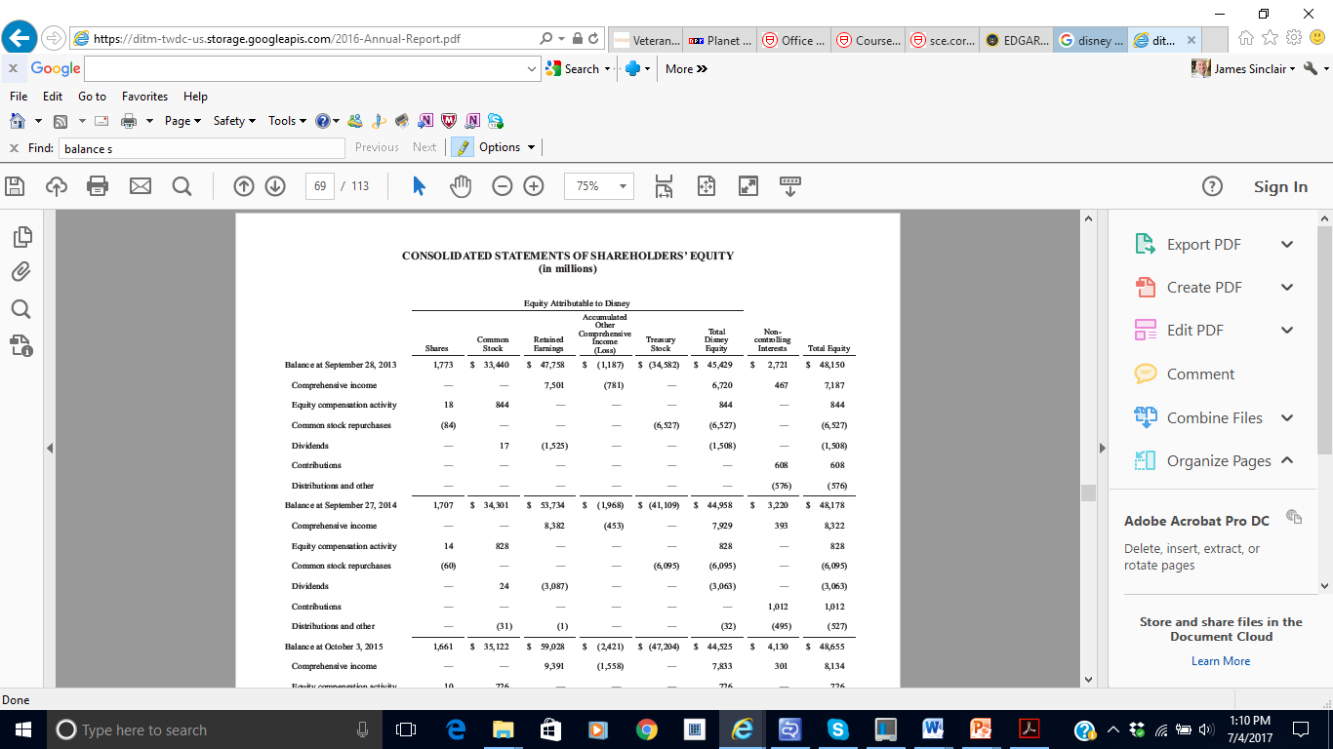
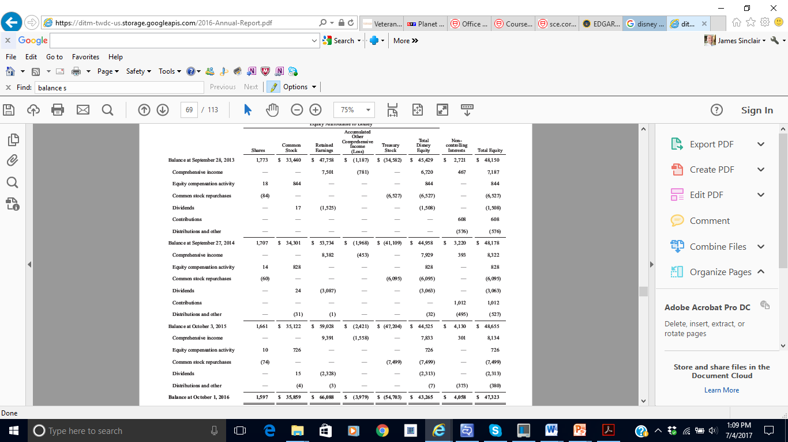
Statement of Stockholders’ Equity

Slide 34

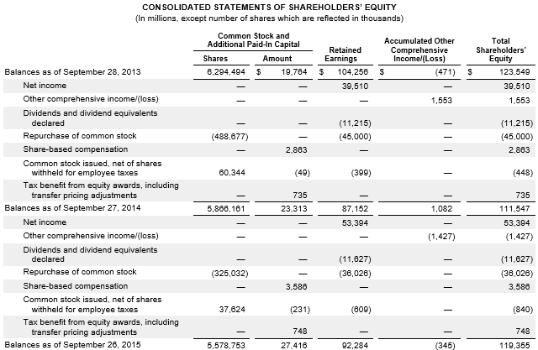
Statement of Stockholders’ Equity

Slide 35
Statement of Cash Flows
Operating
Investing
Financing

Slide 36
Statement of Cash Flows
The statement of cash flows reports inflows (receipts; positive number) and outflows (payments; negative number) of cash for a stated period of time, classified into three (3) categories:
Operating Activities (CFO)
cash flows that are directly related to earning income (i.e., the day-to-day operations of the business, such as purchasing materials from suppliers, delivering products and services to customers, collecting cash from customers, and paying suppliers)
Investing Activities (CFI)
cash flows in this section are associated with the acquisition and sale of productive assets (other than inventory) and investments in other companies (i.e., buildings, land, equipment)
Financing Activities (CFF)
cash flows directly related to the financing of the enterprise itself (i.e., borrowing or paying back money to lenders and receiving additional funds from stockholders or paying out dividends)
Change in Cash = CFO + CFI + CFF

Slide 37
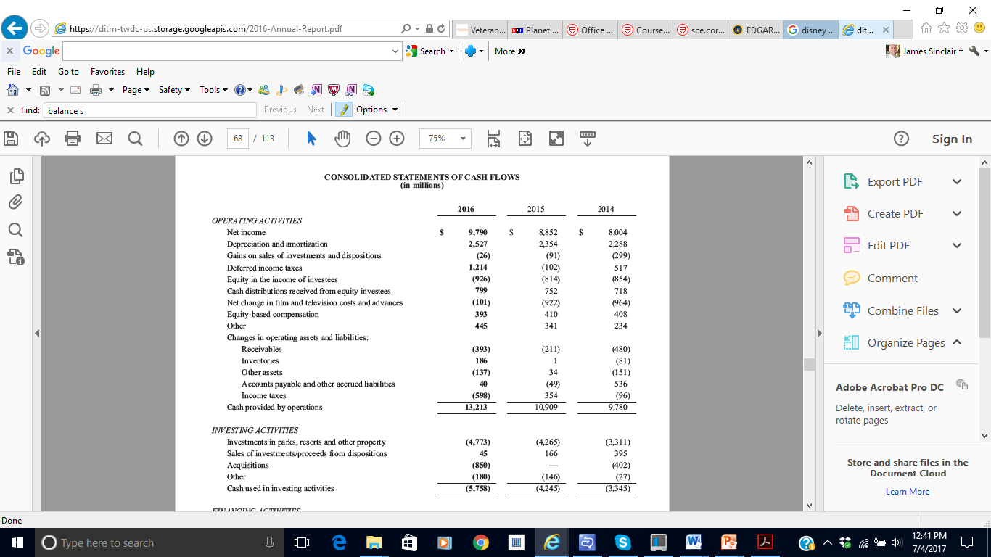
Statement of Cash Flows
CFO
CFI

Slide 38
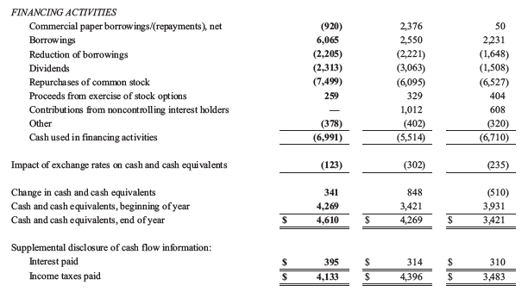
Statement of Cash Flows
CFF

Slide 39
Notes to the Financial Statements

Slide 40
Notes to the Financial Statements
All financial statements should be accompanied by notes that provide the reader with supplemental information about the financial condition and results of operations of the company, without which the financial statements cannot be fully understood.
There are three basic types of notes:
Descriptions of the accounting rules applied in the company’s financial statements
Additional details about a line on the financial statement (i.e., a note that describes the details of a long-term debt agreement)
Additional financial disclosures about items not listed in the financial statements (i.e., a company may disclose that it leased, rather than purchased, major pieces of machinery and equipment)
Important note: Many valuable assets and liabilities are not reported on the balance sheet. Intangible assets may be developed internally over time, rather than purchased. These intangible assets include trademarks, patents, and copyrights, and are NOT recorded on a firm’s B/S. Many companies have off-balance-sheet financing. The most common form of such financing is in the form of leases. These obligations are not (yet) reported as liabilities on the face of the balance sheet.

Slide 41
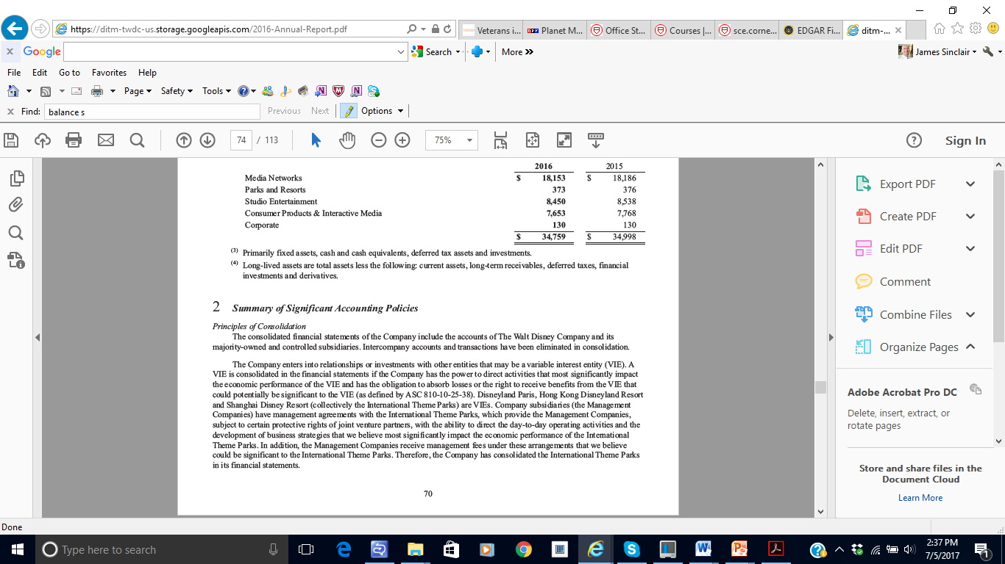
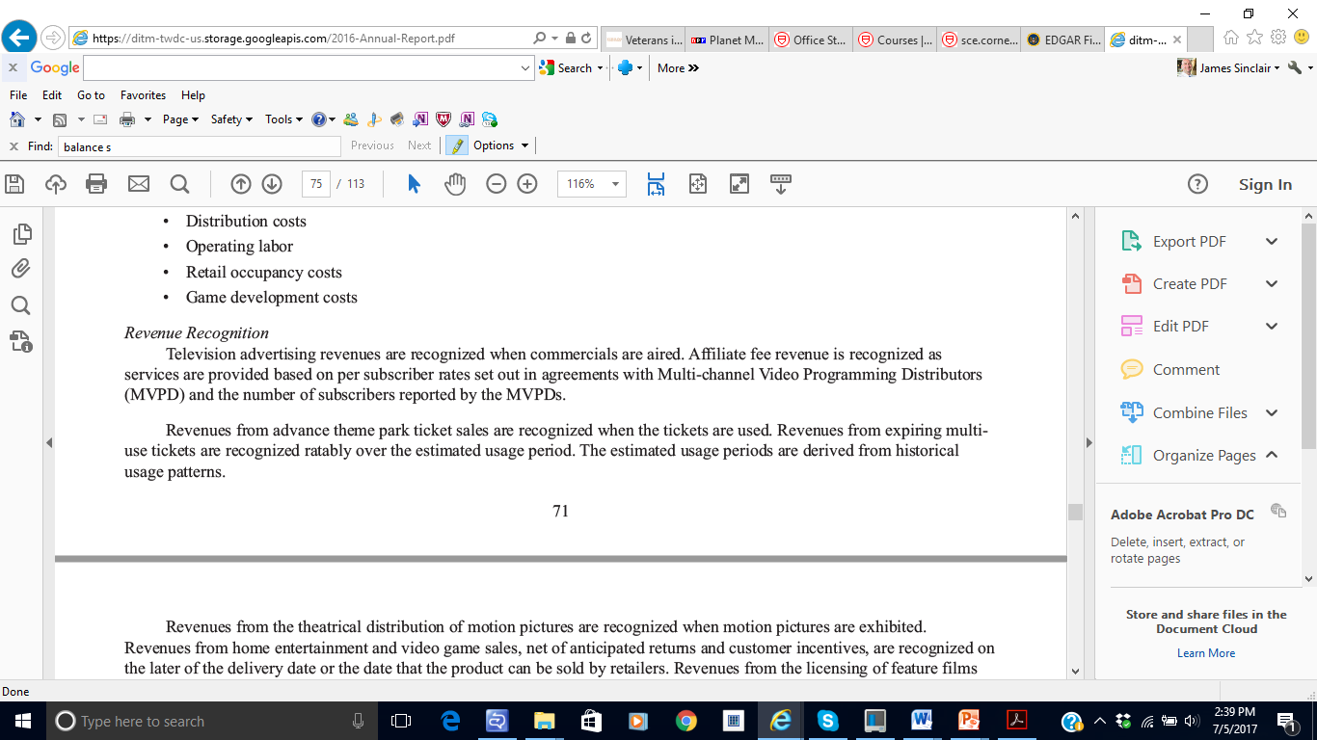
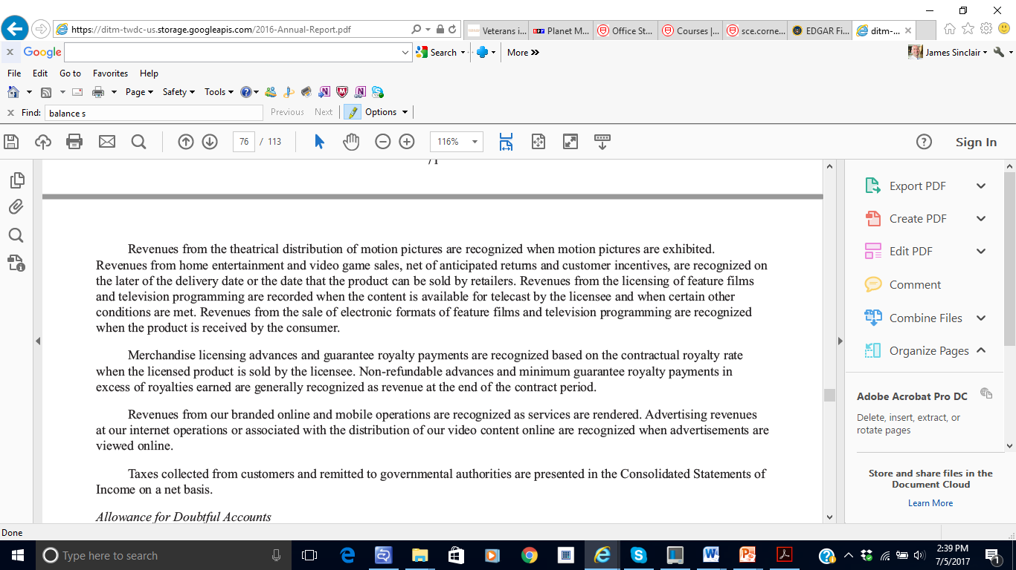
Notes to the Financial Statements
Generally Accepted Accounting Principles (GAAP) permit companies to select from alternative methods for measuring the effects of transactions. The summary of significant accounting policies tells users which accounting methods the company has adopted. Without an understanding of the various accounting methods used, it is impossible to analyze a company’s financial results effectively.

Slide 42
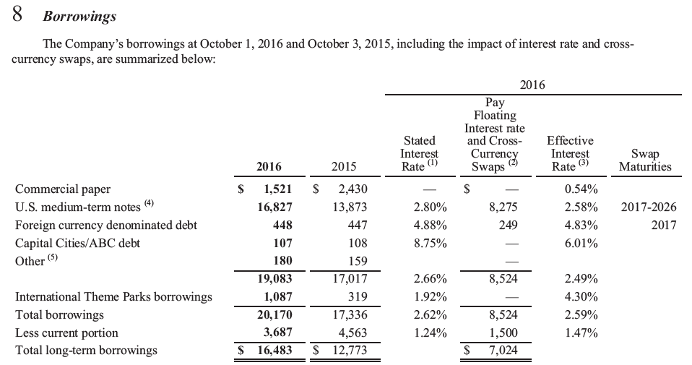
Notes to the Financial Statements
Notes may also provide supplemental information concerning the data shown on the financial statements. Among other information, these notes may show revenues broken out by geographic region or business segment, describe unusual transactions, and/or offer expanded detail on a specific classification.

Slide 43
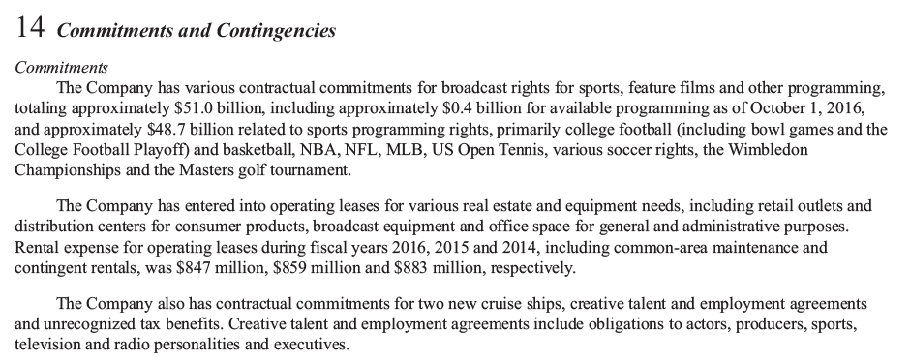
Notes to the Financial Statements
Notes may also include information that impacts the company financially but is not shown on the statements. Examples include information on legal matters and contractual agreements that do not result in an asset or liability on the balance sheet.

Slide 44
Financial Statement Relationships

Slide 45
Financial Statement Relationships
Several relationships exist among the individual financial statements
Revenue
Expense
Net Income
Common Stock and APIC Beg. Bal. + Stock issuances - Stock repurchases End. Bal
Retained Earnings Beg. Bal. + Net Income - Dividends End. Bal
Assets | Liabilities
 | Equity

Slide 46
Generally Accepted Accounting Principles
(GAAP)

Slide 47



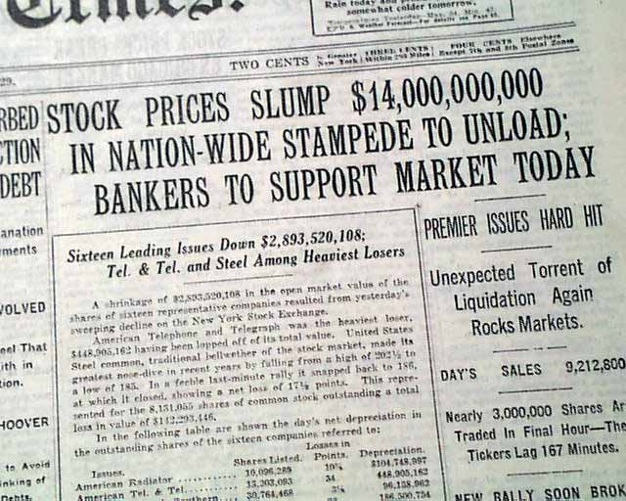
GAAP
Brief History Lesson:
Luca Pacioli, an Italian monk and mathematician, published the first elements of our double-entry bookkeeping system in 1494. Until the stock market crash of 1929, most companies determined their own accounting practices. There was little uniformity or comparability of accounting information. Congress stepped in to regulate accounting measurement in 1933.

Slide 48
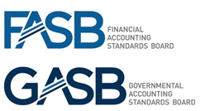
GAAP
Decision makers need to understand the measurement rules applied in computing the numbers on the financial statements. These rules are called Generally Accepted Accounting Principles, or GAAP.
In the United States, Congress created the Securities and Exchange Commission (SEC) and gave it broad powers to determine the measurement rules for financial statements that companies issuing stock to the public (publicly traded companies) must provide to stockholders.
The Securities and Exchange Commission has worked with organizations of professional accountants to establish groups that are given the primary responsibility to work out the detailed rules that become generally accepted accounting principles (GAAP).
Currently, the Financial Accounting Standards Board (FASB) has the responsibility to formulate generally accepted accounting principles. The official pronouncements of the FASB are called the FASB Accounting Standards Codification.

Slide 49
GAAP
Generally accepted accounting principles (GAAP) are of great interest to capital market participants. Companies and their managers and owners are most directly affected by the information presented in financial statements. Companies incur the cost of preparing the statements and bear the major economic consequences of their publication, which include, among others:
Effects on the selling price of a company’s stock
Effects on the amount of bonuses received by management and employees
Loss of competitive information to other companies
Primary responsibility for the information in the financial statements lies with management. Companies take three important steps to assure investors that the company’s records are accurate:
maintain system of controls over both the records and the assets of the company
hire external independent auditors to audit the fairness of financial statements
form committee within the board of directors to oversee the integrity of these other two safeguards.

Slide 50
Independent Auditors
Auditors express an opinion as to the fairness of the financial statement presentation.
Independent auditors have responsibilities that extend to the general public.
An audit involves:
Examining the financial reports to ensure compliance with GAAP
Examining the underlying transactions incorporated into the financial statements
Expressing an opinion as to the fairness of presentation of financial information

Slide 51

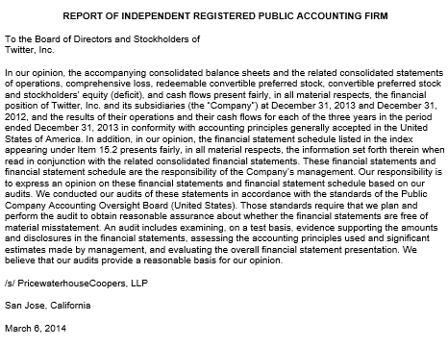
Independent Auditors

Slide 52
International Perspective
Since 2002, there has been substantial movement toward the adoption of International Financial Reporting Standards (IFRS) issued by the International Accounting Standards Board (IASB). The use of IFRS is increasing, with many countries or jurisdictions either currently requiring IFRS or committed to requiring IFRS.
In the United States, the Securities and Exchange Commission now allows foreign companies whose stock is traded in the U.S. to use IFRS and is considering requiring the use of IFRS for U.S. domestic companies.
Examples of jurisdictions requiring the use of IFRS:
European Union
Israel and Turkey
Australia and New Zealand
Brazil and Chile
Hong Kong, India, Malaysia, and South Korea
Canada and Mexico

Slide 53
Ethical Conduct

Slide 54
Ethical Conduct
Ethics are standards of conduct for judging right from wrong, honest from dishonest, and fair from unfair. Many situations are not clear-cut and require that individuals weigh one moral principle (e.g., honesty) against another (e.g., loyalty to a friend).
When money is involved, people can easily fool themselves into believing that bad acts are justified. To avoid falling prey to this tendency, when faced with an ethical dilemma, it is often recommended that you follow a three-step process:
Identify the benefits of a decision (often to the manager or employee involved) and who will be harmed (other employees, owners, creditors, the environment).
Identify alternative courses of action.
Choose the one you would like your family and friends to see reported on your local news. That is usually the ethical choice.

Slide 55
Types of Business Entities

Slide 56
Types of Business Entities
Sole proprietorship
owned by one person; usually small in size and is common in the service, retailing, and farming industries. A sole proprietorship is not legally separate from its owner, and the owner bears unlimited liability.
Partnership
owned by two or more persons known as partners. Similar to a sole proprietorship, a partnership is not legally separate from its owners, and each general partner has unlimited liability.
Corporation
ownership represented by shares of stock. Owners are called stockholders or shareholders.
Advantages of Corporations:
limited liability for the stockholders
continuity of life
ease in transferring ownership (stock)
opportunities to raise large amounts of money by selling shares to a large number of people
Disadvantages of corporations
income may be subject to double taxation (income is taxed when it is earned and again when it is distributed to stockholders as dividends).

Slide 57
End of Chapter 01

